Slide 1

BASIC OF CIVIL ENGINEERING (TCE 101)
UNIT- 2 (SYLLABUS)
Surveying:
Introduction: Object, Principles & Types of Surveying; Site Plans, Plans & Maps; Scales & Unit of different Measurements.
Linear Measurements: Linear Measurement by Tape, Ranging out Survey Lines and overcoming obstructions.
Modern distance measuring equipment like Laser Distance Meter (LDM), etc.
Angular Measurements: Introduction to Compass Surveying, Bearings. Introduction to the total station.
Modern Tools of Surveying and Mapping: Introduction to Global Positioning System, Remote Sensing and Geographic Information System.
Survey Lab Visit and measurement activity.

Slide 2
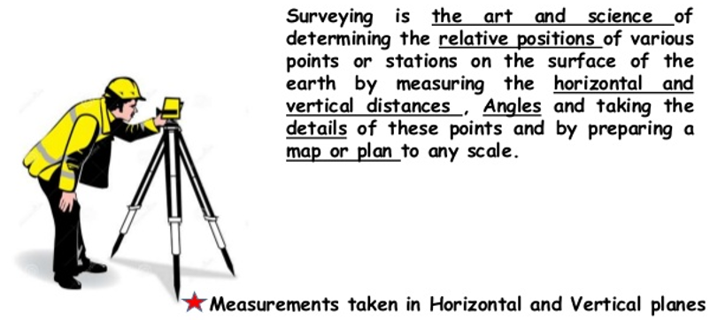
Definition of Surveying

Slide 3
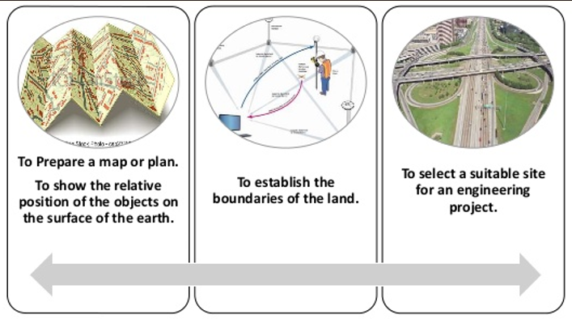
Objects of Surveying

Slide 4
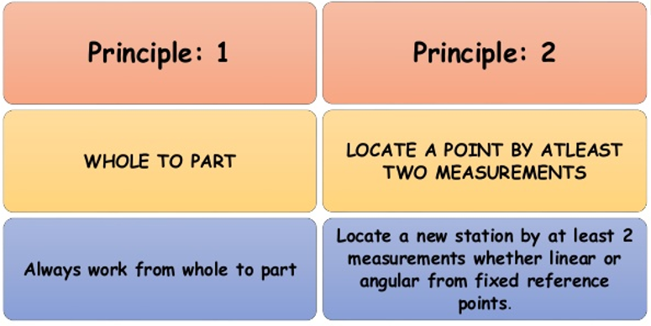
Fundamental Principles of Surveying

Slide 5
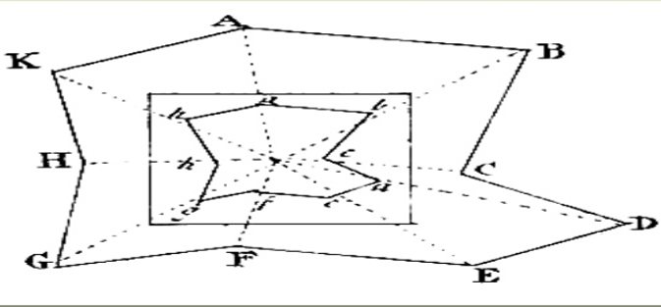
Fundamental Principles of Surveying
Always work from whole to part:
According to the first principle, the whole survey area is first enclosed by main stations (i.e.. Control stations) and main survey lines. The area is then
divided into a number of divisions by forming well conditioned triangles.
The main survey lines are measured very accurately with precise survey instruments. The remaining sides of measured. The purpose of this method of working The triangle are is to control accumulation of errors. During measurement, if there is any error, then it will not affect the whole work, but if the reverse process is followed then the minor error in measurement will be magnified.

Slide 6
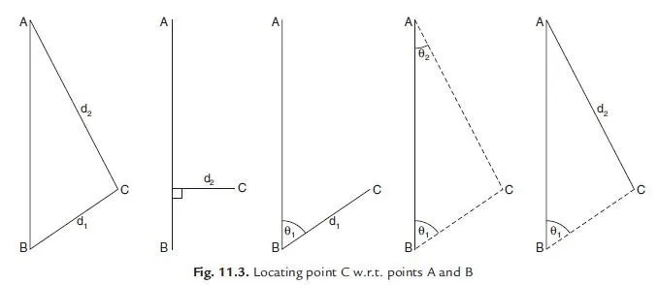
Fundamental Principles of Surveying
Locate the position of a point by measurement from two reference points
According to the second principle the points are located by linear or angular measurement or by both in surveying.
Taking linear measurement from A and B for C.
Taking linear measurement of perpendicular from D to C.
Taking one linear measurement from B and one angular measurement as angle ABC
Taking two angular measurement at A & B as angles CAB and ABC.
Taking one angle at B as / ABC and one linear measurement from A as AC.

Slide 7
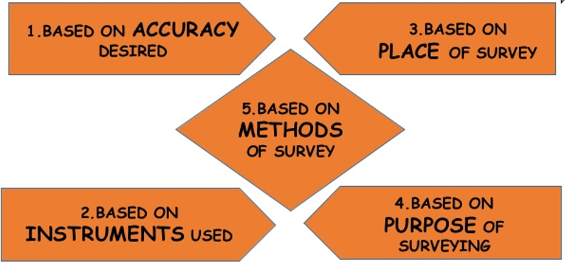
Classification of Surveying

Slide 8
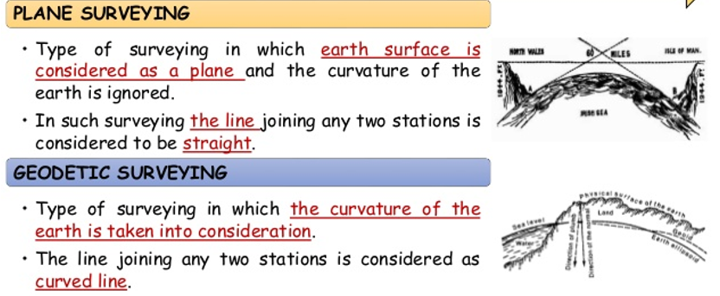
Classification of Surveying
BASED ON ACCURACY DESIRED:

Slide 9
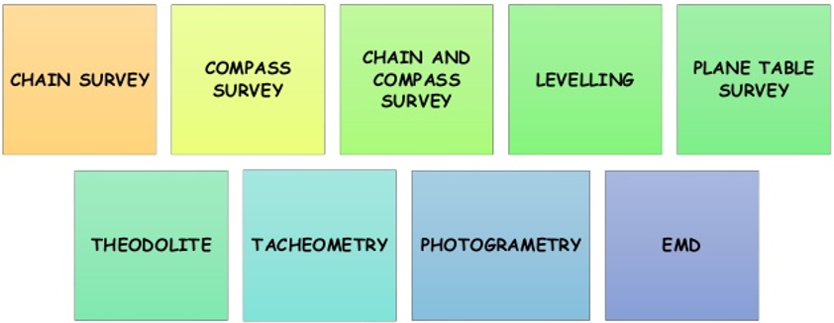
Classification of Surveying
BASED ON INSTRUMENTS USED:

Slide 10
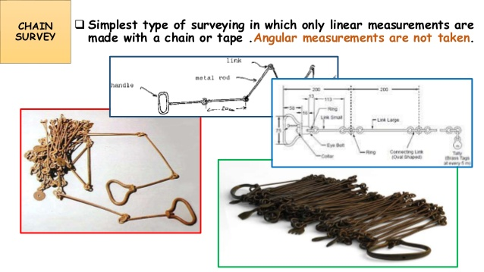
Classification of Surveying
BASED ON INSTRUMENTS USED:

Slide 11
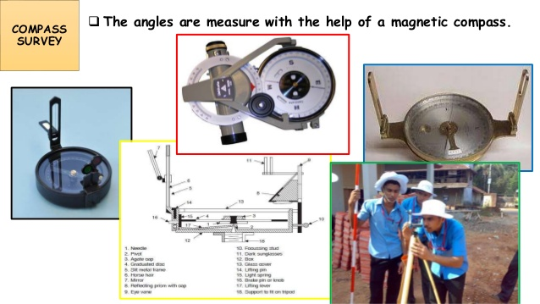
Classification of Surveying
BASED ON INSTRUMENTS USED:

Slide 12
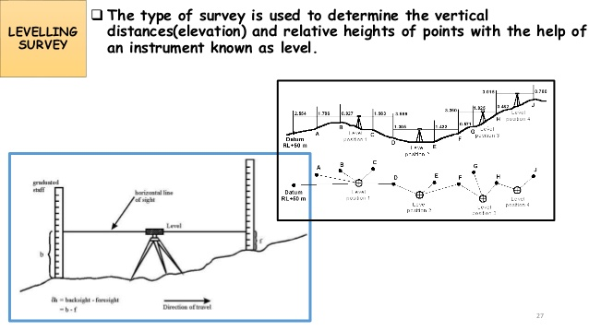
Classification of Surveying
BASED ON INSTRUMENTS USED:

Slide 13
Classification of Surveying
TYPES OF LEVELLING
  The following are some of the types of levelling:
    Simple levelling
    Differential levelling
  Before that the you should understand the following terms:
    Back sight
    Fore sight
    Intermediate sight,

Slide 14
Classification of Surveying
TYPES OF LEVELLING
Back Sight : It is the sight taken on a level staff, held at a point of known elevation with an intention of determining the plane of collimation (elevation of line of sight). It is always the first reading after setting the instrument. When this reading is added to the reduced level of the staff point, plane of collimation is obtained.
Fore Sight : This is the last reading taken from an instrument. After this reading is taken the instrument is shifted. When this reading is subtracted from the plane of collimation, the R.L. of point where staff is held, is obtained.
Intermediate Sight : Excluding back sight and fore sight all other readings taken from an instrument stations are called intermediate sights. When these readings are subtracted from plane of collimation, the R.L. of points where staff is held, are obtained.

Slide 15
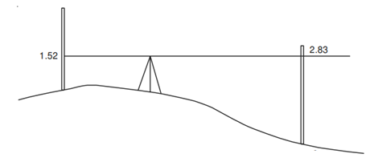
Classification of Surveying
TYPES OF LEVELLING
  Simple Levelling
    When difference in levels of two nearby points are required, it is obtained by simple levelling. Two points are so near that with one setting of the level, the reading on both points can be obtained.
  Let the reduced level of point A known and R.L. of point B is required.

Slide 16
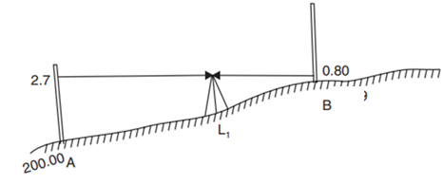
Classification of Surveying
TYPES OF LEVELLING
Finding difference between the levels of two nearby points. one such case in which level of A is assumed, say 200.00 m. RL of B is required.

Slide 17
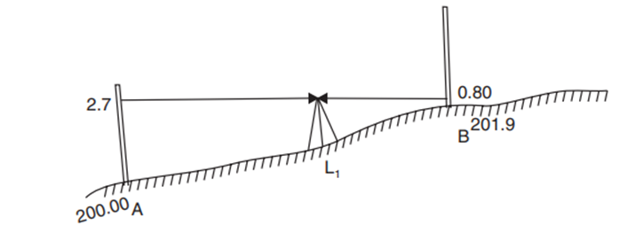
Classification of Surveying
TYPES OF LEVELLING
RL of A = 200.00 m
Back sight on A = 2.7 m.
∴ Plane of collimation for setting at station
= 200 + 2.7 = 202.7 m
Fore sight on B = 0.80 m
∴ RL of B = 202.7 – 0.80 = 201.9 m
It may be noted that the instrument station L₁ need not be along the line AB (in plan) and RL of L₁ do not appear in the calculations.

Slide 18
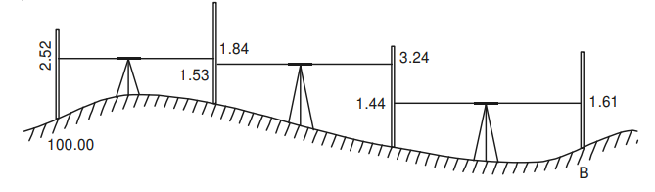
Classification of Surveying
TYPES OF LEVELLING
  Differential Leveling
    If the distance between the two points A and B is too large, it will not be possible to take the readings from a single setting of the instrument. In such situations, differential leveling may be carried out. This method needs setting of instrument at more than one point, each shifting facilitated by a change point.

Slide 19
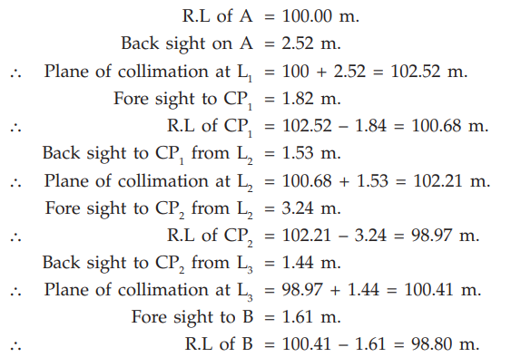
Classification of Surveying
TYPES OF LEVELLING
Differential leveling is used for setting out various benchmarks and for determining elevation of different points.

Slide 20
Thank you

